Slide 1
Basics of C#
Unit – II

Slide 2
Contents
Hello World program
Data types and related concepts
Input and output
Operators
Conditional statements
Iteration statements
Jump Statements
Exception Handling
Arrays

Slide 3
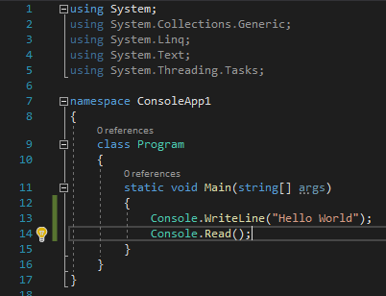
Hello World in C#

Slide 4
Data Types in C#
You must remember that .NET framework has a common type system.
This means that the data types available in one .NET framework compliant language are also available in another .NET framework compliant language.
There are two kinds of types in C#: value types and reference types.
Variables of value types directly contain their data whereas variables of reference types store references to their data, reference types are also known as objects.

Slide 5
Data Types in C#
With reference types, it's possible for two variables to reference the same object and thus possible for operations on one variable to affect the object referenced by the other variable.
With value types, the variables each have their own copy of the data, and it isn't possible for operations on one to affect the other.
C#'s value types are further divided into simple types, enum types, struct types, and nullable value types. C#'s reference types are further divided into class types, interface types, array types, and delegate types.

Slide 6
Data Types in C#
Value Types
Simple Types
Signed Integral: sbyte, short, int, long
Unsigned Integral: byte, ushort, uint, ulong
Unicode characters: char
IEEE binary floating point: float, double
High precision floating point: decimal
Boolean: bool
Enum Types
User defined types of form enum E{...}
Struct Types
User-defined types of the form struct S {...}
Nullable Value Types
Extensions of all other value types with a null value
Tuple Value Types
User-defined types of the form (T1, T2, ...)

Slide 7
Data Types in C#
Reference Types
Class Types
Ultimate base class of all other types: object
Unicode strings: string
User-defined types of the form class C {...}
Interface types
User-defined types of the form interface I {...}
Array types
Single- and multi-dimensional, for example, int[] and int[,]
Delegate types
User-defined types of the form delegate int D(...)

Slide 8

Data Types in C#
Simple value types

Slide 9

Data Types in C#
Char

Slide 10
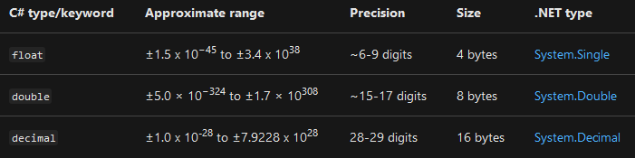
Data Types in C#
IEEE binary floating point

Slide 11
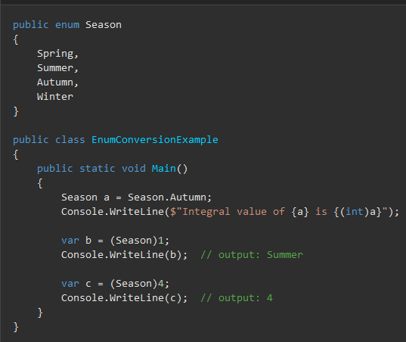
Data Types in C#
Enum Type

Slide 12
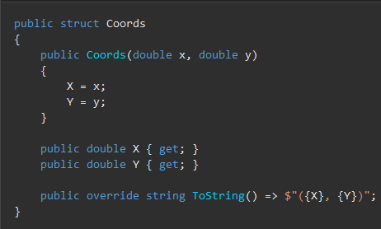
Data Types in C#
Struct Type

Slide 13
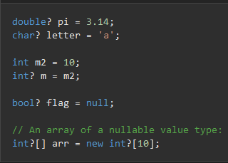
Data Types in C#
Nullable Type

Slide 14
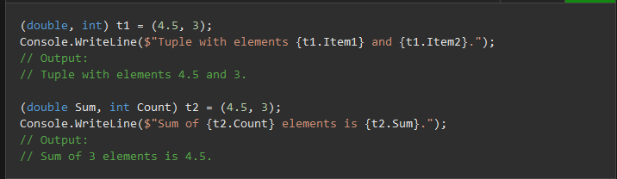
Data Types in C#
Tuple Type

Slide 15
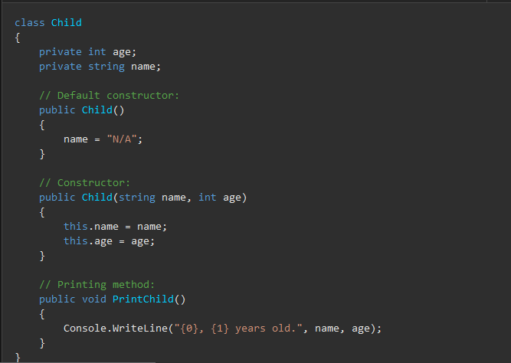
Data Types in C#
Class Type

Slide 16

Data Types in C#
Interface

Slide 17
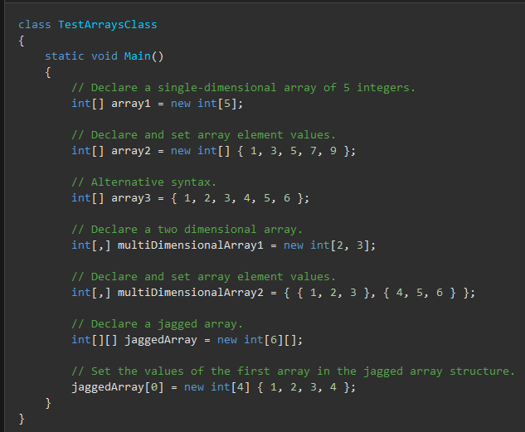
Data Types in C#
Array Type

Slide 18
Boxing and Unboxing Concepts
C#'s type system is unified such that a value of any type can be treated as an object.
Every type in C# directly or indirectly derives from the object class type, and object is the ultimate base class of all types.
Values of reference types are treated as objects simply by viewing the values as type object.
Values of value types are treated as objects by performing boxing and unboxing operations.

Slide 19
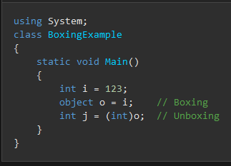
Boxing and Unboxing Concepts
In the following example, an int value is converted to object and back again to int.

Slide 20



Data Types in C#
Integer and byte types

Slide 21

Data Types in C#
Integer literals can be:

Slide 22
Input – Output in C#
Output in C#
Console.Write(“”) – Writes a line on console. Takes string type arguments.
Console.WriteLine(“”) – Writes a line on the console and adds a new line character at the end. Takes a string type of argument.

Slide 23
Input – Output in C#
Input in C#
Console.Read() – Reading a single character.
Console.ReadLine() – Reading a line up to newline character.
Console.Readkey() – Reading next character from keyboard.
All above methods are returning values in string type.

Slide 24
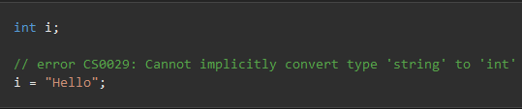
Implicit and Explicit Casting
Because C# is statically-typed at compile time, after a variable is declared, it cannot be declared again or assigned a value of another type unless that type is implicitly convertible to the variable's type.
For example, the string cannot be implicitly converted to int. Therefore, after you declare i as an int, you cannot assign the string "Hello" to it, as the following code shows

Slide 25
Implicit and Explicit Casting
However, you might sometimes need to copy a value into a variable or method parameter of another type.
For example, you might have an integer variable that you need to pass to a method whose parameter is typed as double.
Or you might need to assign a class variable to a variable of an interface type.
These kinds of operations are called type conversions. In C#, you can perform the following kinds of conversions:

Slide 26
Implicit and Explicit Casting
Implicit conversions: No special syntax is required because the conversion always succeeds and no data will be lost. Examples include conversions from smaller to larger integral types, and conversions from derived classes to base classes.
Explicit conversions (casts): Explicit conversions require a cast expression. Casting is required when information might be lost in the conversion, or when the conversion might not succeed for other reasons. Typical examples include numeric conversion to a type that has less precision or a smaller range, and conversion of a base-class instance to a derived class.

Slide 27

Implicit and Explicit Casting
Implicit Casting

Slide 28
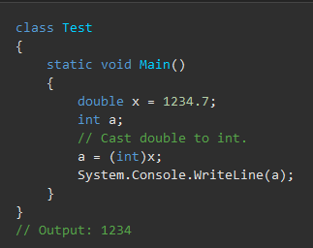
Implicit and Explicit Casting
Explicit Casting

Slide 29
Checked and Unchecked Blocks
C# statements can execute in either checked or unchecked context.
In a checked context, arithmetic overflow raises an exception.
In an unchecked context, arithmetic overflow is ignored and the result is truncated by discarding any high-order bits that don't fit in the destination type.

Slide 30
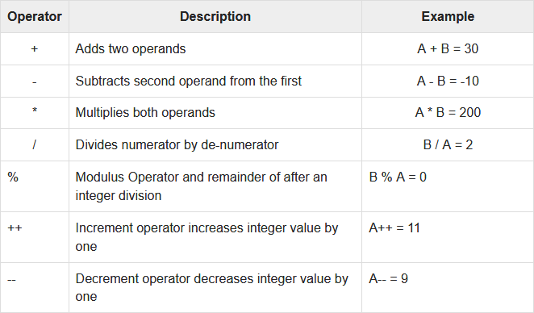
Operators
Arithmetic Operators

Slide 31
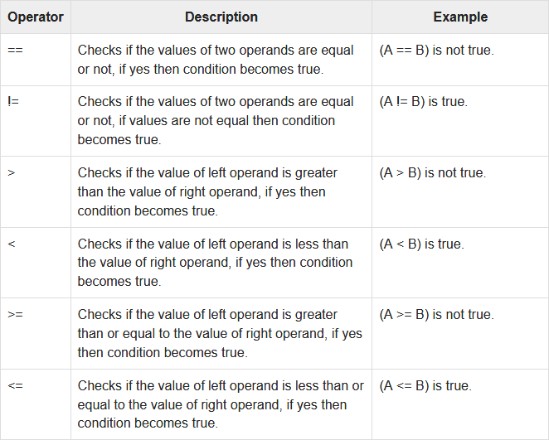
Operators
Relational Operators

Slide 32
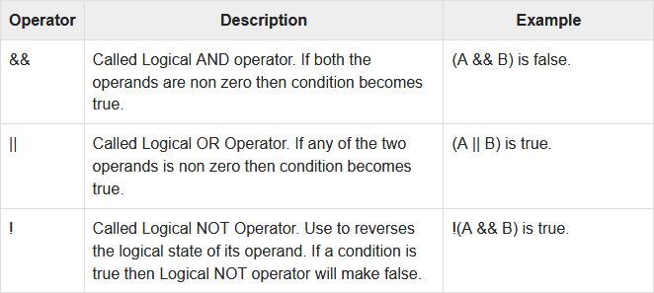
Operators
Logical Operators

Slide 33
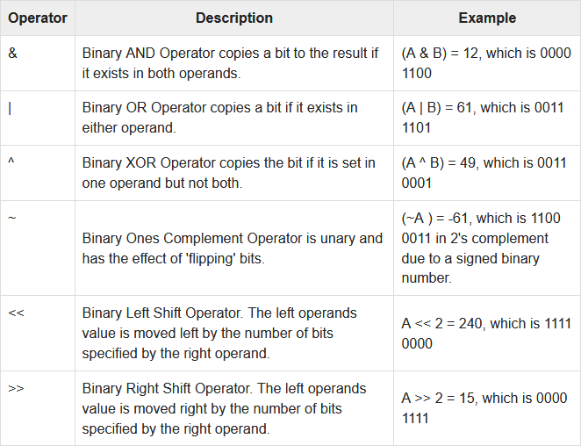
Operators
Bitwise Operators

Slide 34
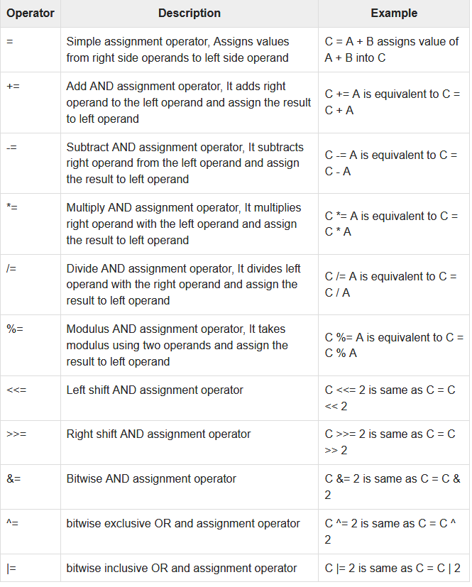
Operators
Assignment Operators

Slide 35
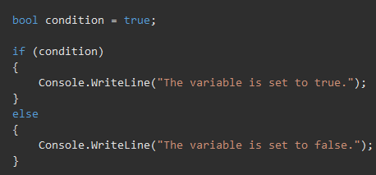
Conditional Statements

Slide 36
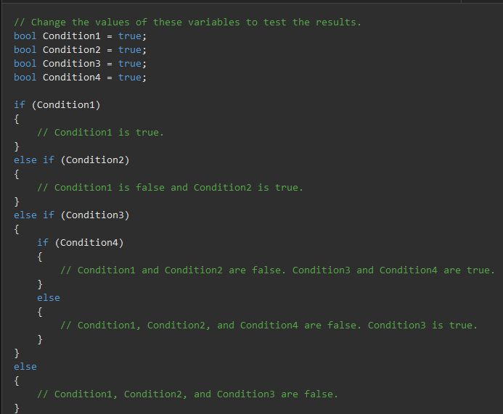
Conditional Statements

Slide 37
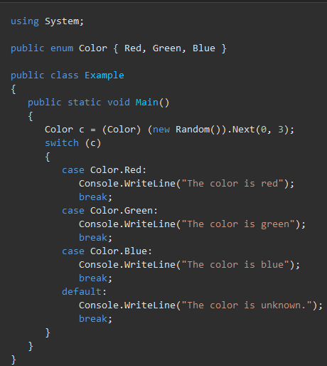
Conditional Statements

Slide 38
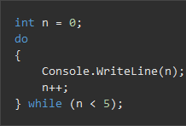
Iteration in C#
do

Slide 39

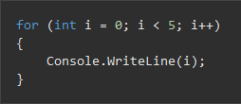
Iteration in C#
For

Slide 40
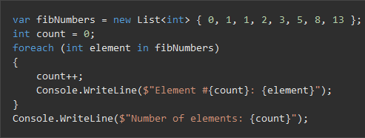
Iteration in C#
Foreach, In

Slide 41
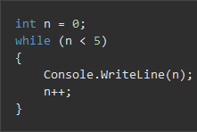
Iteration in C#
While

Slide 42
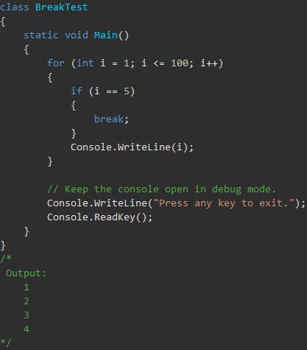
Jump Statements in C#
break

Slide 43
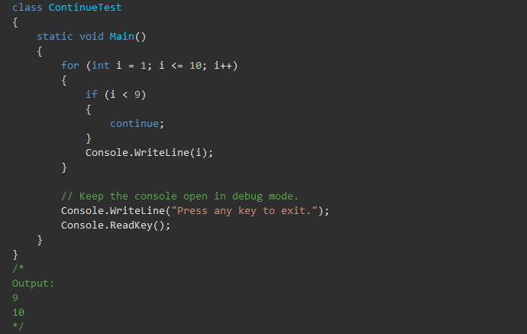
Jump Statements in C#
Continue

Slide 44
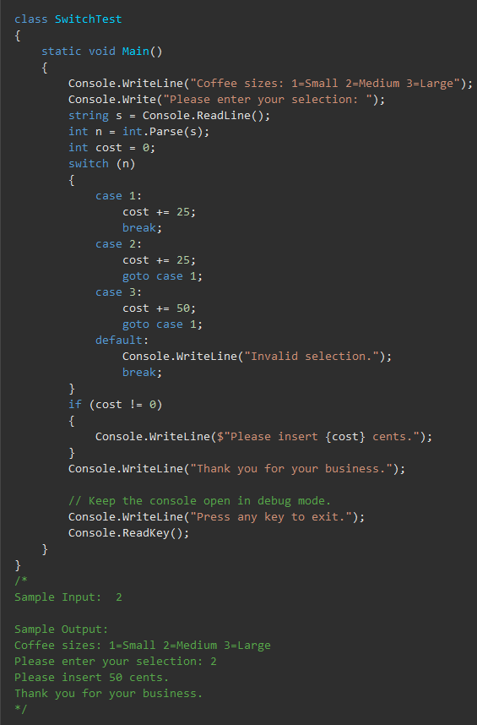
Jump Statements in C#
Goto

Slide 45
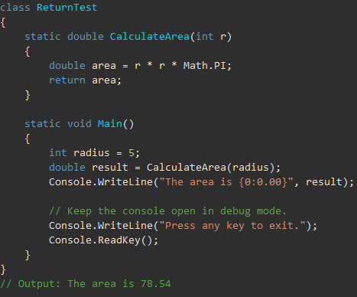
Jump Statements in C#
Return

Slide 46
Exception Handling in C#
There are two types of exceptions in c#: i) User defined exceptions ii) Built-in exceptions.
In user defined exception the user has to raise the exception and handle it.
Failing to handle it results in program halting and possibly termination of program.

Slide 47
Exception Handling in C#
Exceptions provide a way to transfer control from one part of a program to another. C# exception handling is built upon four keywords: try, catch, finally, and throw.
try − A try block identifies a block of code for which particular exceptions is activated. It is followed by one or more catch blocks.
catch − A program catches an exception with an exception handler at the place in a program where you want to handle the problem. The catch keyword indicates the catching of an exception.
finally − The finally block is used to execute a given set of statements, whether an exception is thrown or not thrown. For example, if you open a file, it must be closed whether an exception is raised or not.
throw − A program throws an exception when a problem shows up. This is done using a throw keyword.

Slide 48
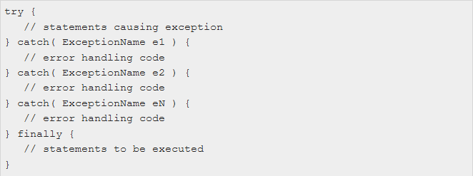
Exception Handling in C#
Syntax

Slide 49
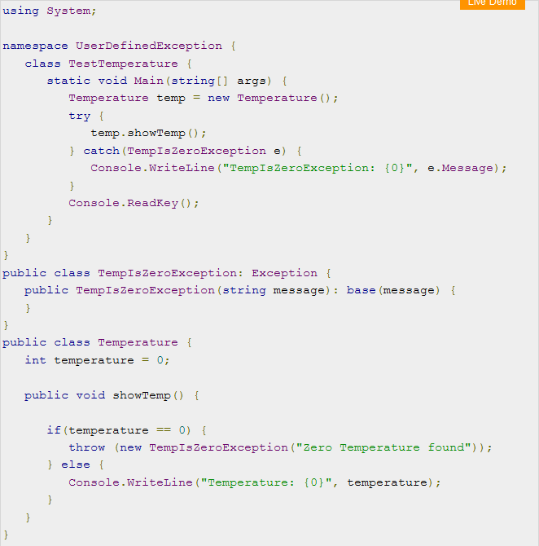
Exception Handling in C#
Throwing and catching user defined exception

Slide 50
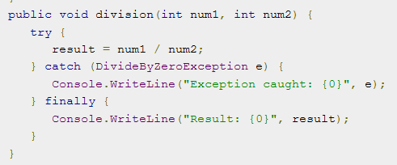
Exception Handling in C#
Catching user defined exceptions:

Slide 51
Arrays in C#
An array is a data structure that contains a number of variables that are accessed through computed indices.
The variables contained in an array, also called the elements of the array, are all of the same type, and this type is called the element type of the array.
Array types are reference types, and the declaration of an array variable simply sets aside space for a reference to an array instance.
Actual array instances are created dynamically at runtime using the new operator.
The new operation specifies the length of the new array instance, which is then fixed for the lifetime of the instance.
The indices of the elements of an array range from 0 to Length - 1.
The new operator automatically initializes the elements of an array to their default value, which, for example, is zero for all numeric types and null for all reference types.

Slide 52
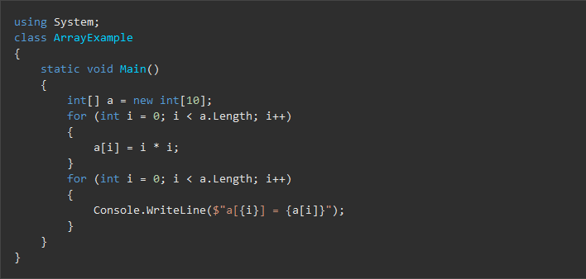
Arrays in C#
Example

Slide 53

Arrays in C#
The number of dimensions of an array type, also known as the rank of the array type, is one plus the number of commas written between the square brackets of the array type.
The following example allocates a single-dimensional, a two-dimensional, and a three-dimensional array, respectively.

Slide 54
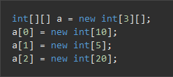
Arrays in C#
An array with elements of an array type is sometimes called a jagged array because the lengths of the element arrays don't all have to be the same. The following example allocates an array of arrays of int:

Slide 55
Arrays in C#

Slide 56
Arrays in C#
The new operator permits the initial values of the array elements to be specified using an array initializer, which is a list of expressions written between the delimiters { and }.
The following example allocates and initializes an int[] with three elements.

Slide 57
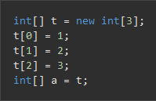
Arrays in C#

